Slide 1

‘LEARNING SYSTEM WEBSITE’
CSE 326 PROJECT NO: 8
KOC49
Submitted By:
Name : Sachin Verma Reg no. : 12224105

Slide 2
Technologies Used:
HTML (Hypertext Markup Language)
CSS (Cascading Style Sheets)

Slide 3
Features:
Structured storage of learning materials.
Students can Enroll
Structured storage of learning materials.
Easy Navigation
We provide best of facility.

Slide 4

SCREENSHOT OF WEBSITE:

Slide 5
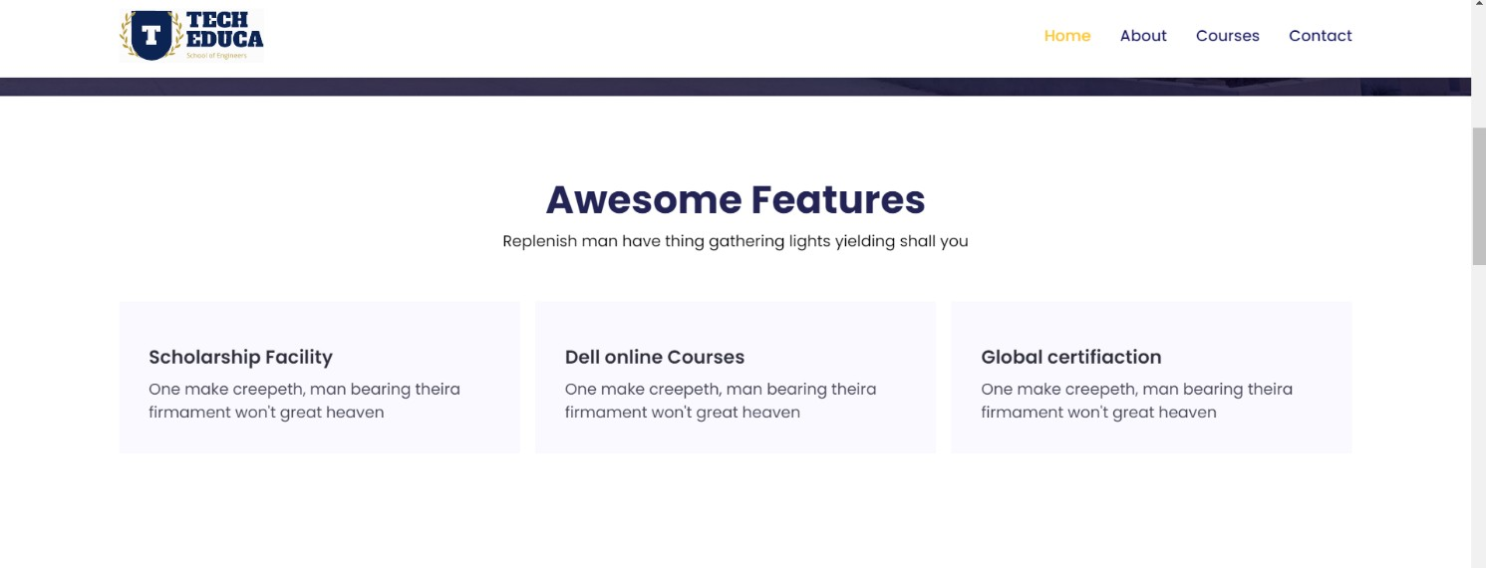

Slide 6


Slide 7


Slide 8
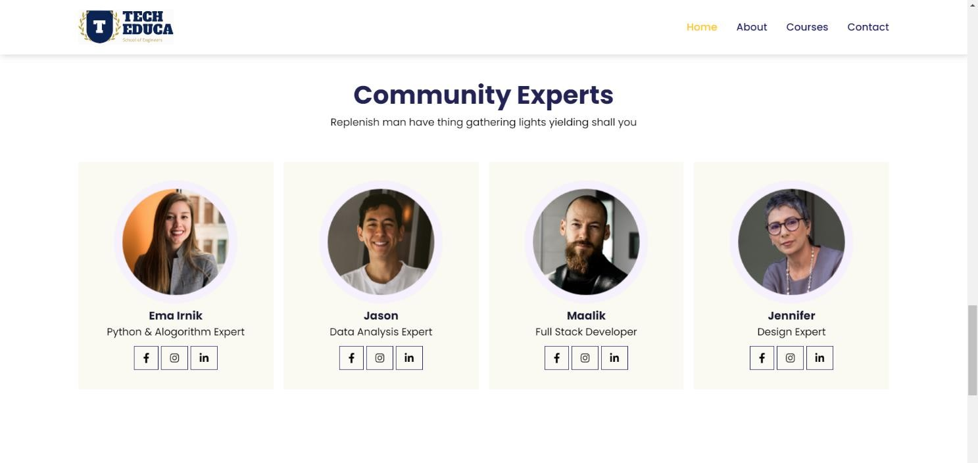

Slide 9
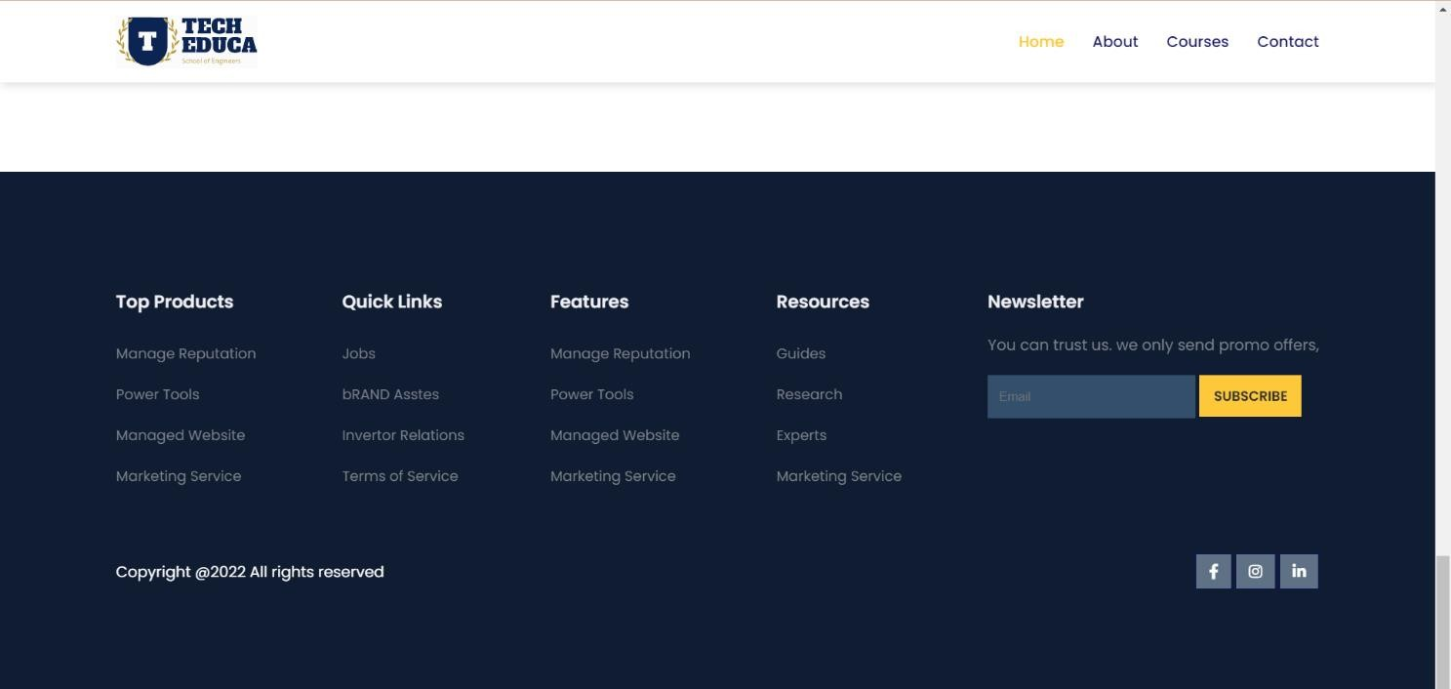

Slide 10


Slide 11


Slide 12
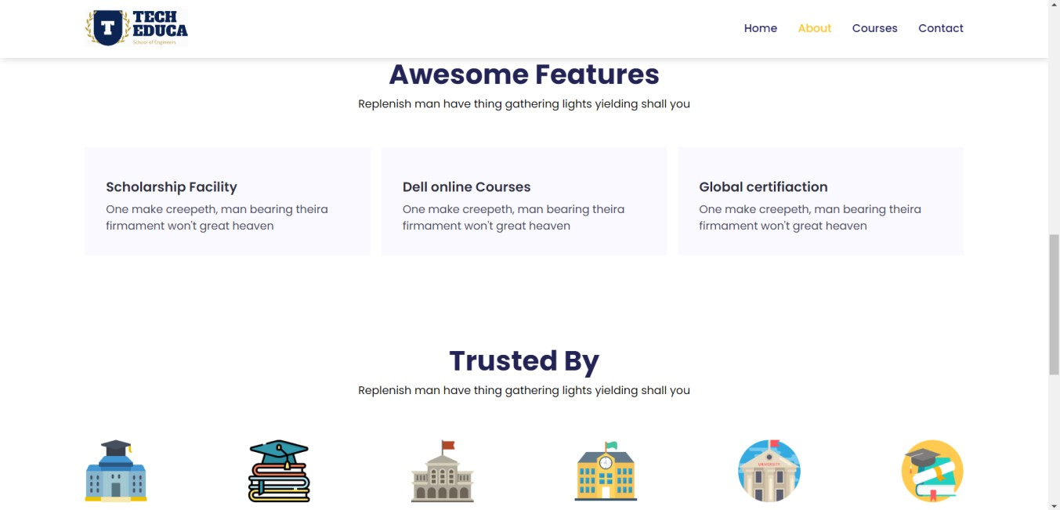

Slide 13



Slide 14
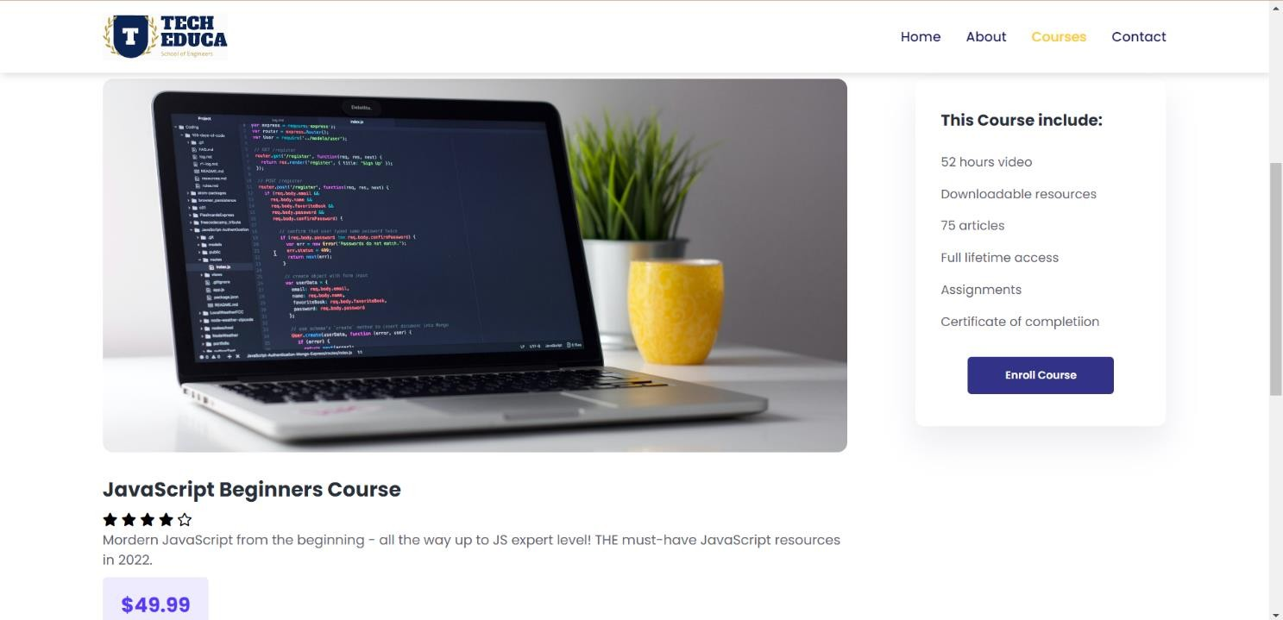

Slide 15


Slide 16


Slide 17
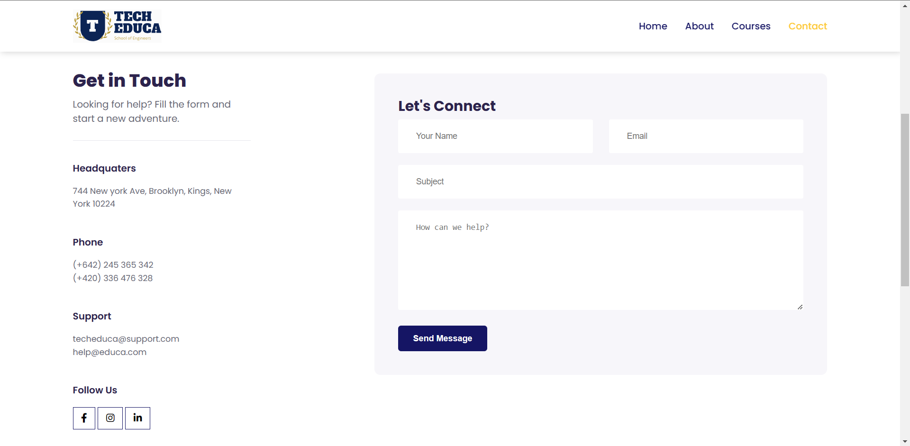

Slide 18
Flow of Project:
Piyush Kesharwani: (Home Page and About)
Sachin Verma: (Courses, CSS, Links)
Jagat Karan Singh: (Contact)

Slide 19
Conclusion:
This website helps to spread education easily at anytime, anywhere in the world.
This is the end of this project....

Slide 20
References:
Google.com
YouTube.com
Books
And the guidance of Ms. Aashima Mam

